Slide 1
Understanding AI for Stories Generation

Slide 2
AGENDA
My Guesses
Prior approaches
GROVE
Can LLMs write good stories?
Can LLMs plan out stories?
Generating plot
Making foundational models

Slide 3
3 Guesses

Slide 4
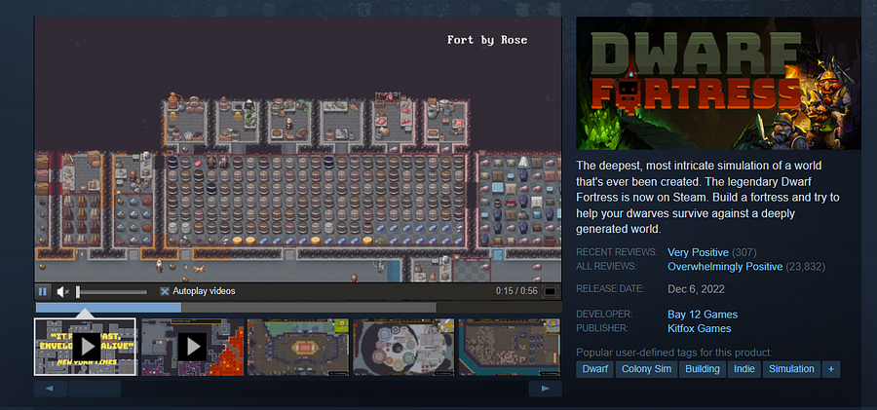
Do a simulation

Slide 5

Have a good story classifier

Slide 6

Take inspiration from history

Slide 7
Now, how are stories generated using AI?

Slide 8
Past APPROACHES
Ending generation
Generation from outlines

Slide 9
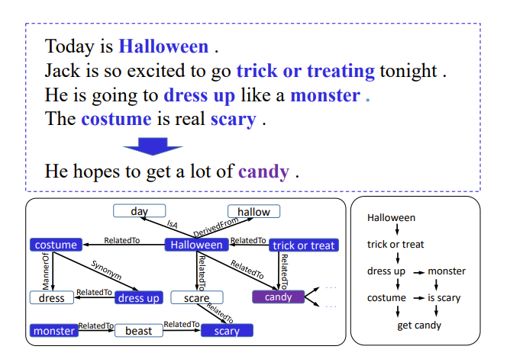
Story Ending Generation with Incremental Encoding and Commonsense Knowledge

Slide 10
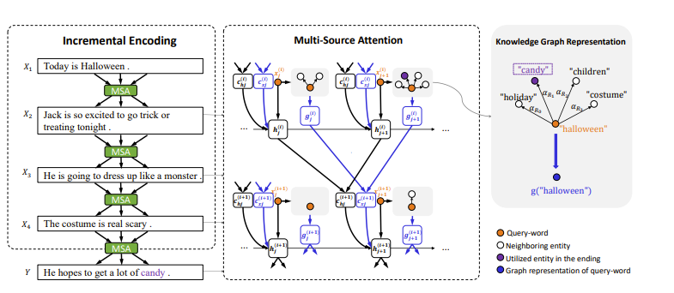

Slide 11
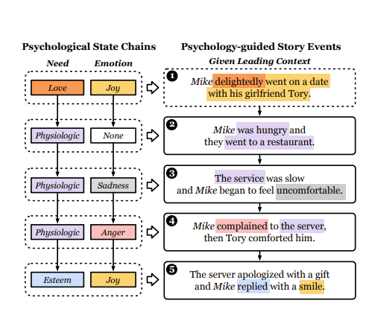
Psychology-guided Controllable Story Generation

Slide 12
Limitations
Requires fine grained human control for good results
Or according to “GROVE: A Retrieval-augmented Complex Story Generation Framework with A Forest of Evidence”
It is “challenging to generate stories with both complex and creative plots. Existing methods often rely on detailed prompts to guide LLMs to meet target conditions, which inadvertently restrict the creative potential of the generated stories.”

Slide 13

GROVE: A Retrieval-augmented Complex Story Generation Framework with A Forest of Evidence

Slide 14
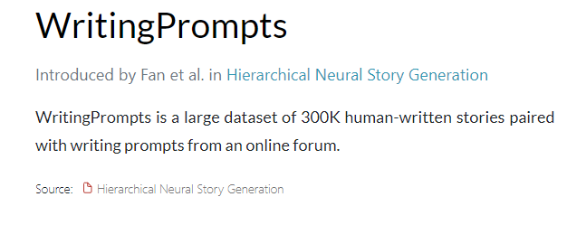
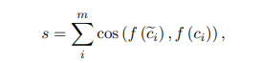
1. Retrieval Repository
Can Retrieve stories based on
Target condition
Extract Conditions with GPT-4(mood/genre etc)

Slide 15
2. Evidence Forest Construction via Asking Why
Given target condition retrieve stories from Retrieval Repository
Using above generate initial story
We have the LLM generate unclear parts of the initial story
Iteratively ask why for each unclear part and have GPT 4 make “evidence”. This will be recursive because each piece of evidence might have an unclear part in it. So by recursively asking until there are no ambiguities, we get an evidence tree for the given ambiguity!
Ambiguity
Sol 1
Sol 2
Sol 3

Slide 16
3. Evidence Chains-supported Story Rewriting
For each evidence chain, the “most suitable evidence chain” for the initial story is selected
The story is rewritten with the given evidence

Slide 17
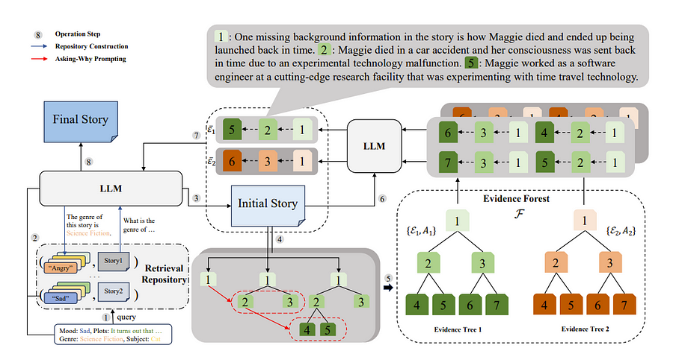

Slide 18
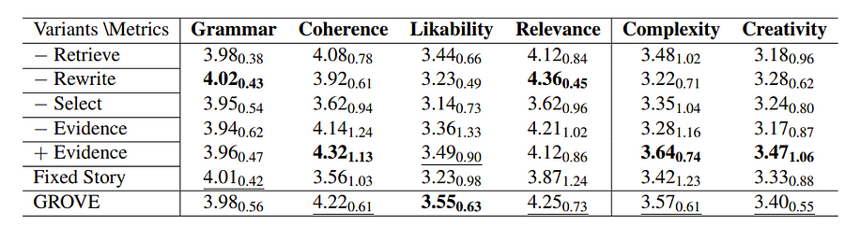
Isn’t this just copying stories from WIKISTORY? NO!
No ngram matches/plagiarism they could find +

Slide 19
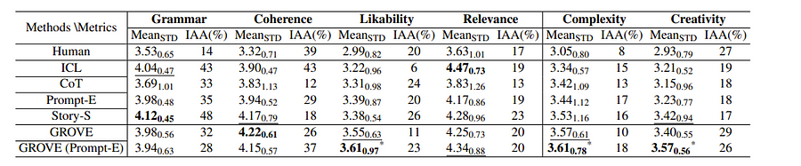
Also outperform humans?

Slide 20
One limitation
Can only handle stories in GPT 4 context length

Slide 21
Now then are we finished? Let’s evaluate the assumptions!
LLMs can write good stories in all other aspects than complexity
LLMs are capable of making complex plots
Are these assumptions true?

Slide 22
can LLMs write good stories in all other aspects than complexity?

Slide 23
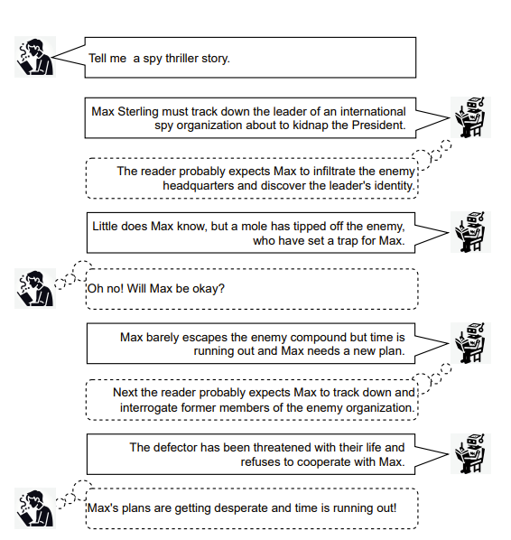
Creating Suspenseful Stories: Iterative Planning with Large Language Models
23
Found LLMs are not good for writing suspense out of the box

Slide 24
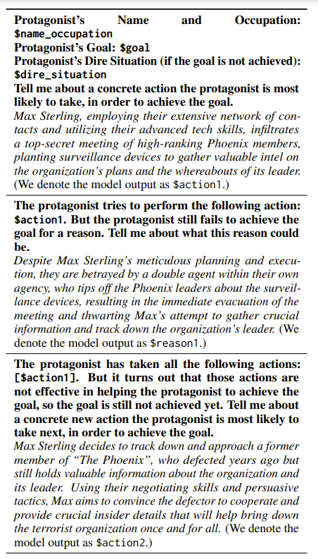
Come up with goal and have an antagonist llm! As for suspense
There must be a protagonist that is empathetic to the reader
That protagonist must face a high possibility of an outcome undesired by the protagonist and the reader
The quantity and quality (roughly in terms of expected probability) of ways of avoiding that undesired outcome are reduced

Slide 25
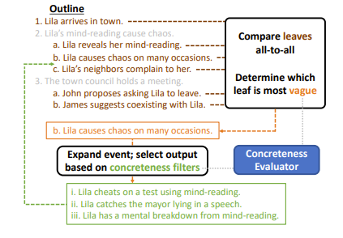
Improving Pacing in Long-Form Story Planning
25
Found LLMs have unnatural pacing
Find the vaguest part of the outline by comparing every fact to each other.
Generate/Expand on it using GPT-4 for it to be more concrete.
-> Generate story

Slide 26
Can LLMs generate complex plots?

Slide 27
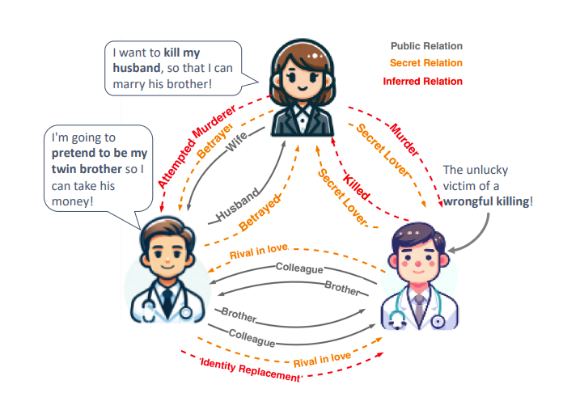
Large Language Models Fall Short: Understanding Complex Relationships in Detective Narratives
authors found that current LLMs have “limitations in inferencing complex relationships and handling longer narratives”.

Slide 28
Evaluating how good LLMs are for relationships is hard
The LLM are already trained on those stories, which I presume are classics like the Gutenberg project
The stories are too simple, ex children's stories where “characters and their relationships are typically introduced when the characters first appear in the narrative”
However, in more complicated stories, the information about each character is “incomplete and uncertain” and can be contradictory for ex lies!

Slide 29
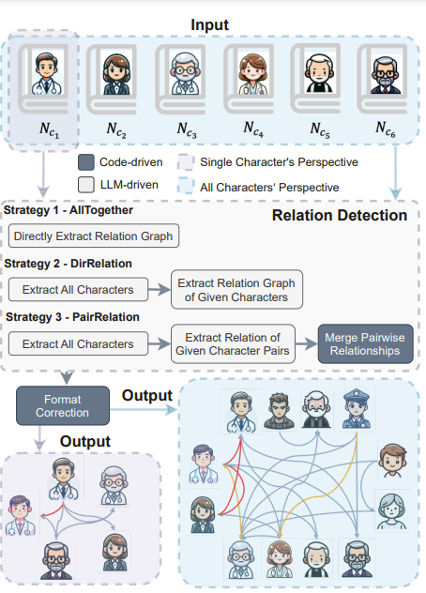
New evaluation! CONAN=COntextual Narrative ANalysis
Input: Narrative of K characters+Background story from each of their perspective
Tasks:
Extract all characters
Link character perspectives from their point of view
Infer hidden relationships

Slide 30
Why is Extract all characters hard?
The characters might have different identities/aliases through different points of the story and LLMs have issue keeping track of this.

Slide 31
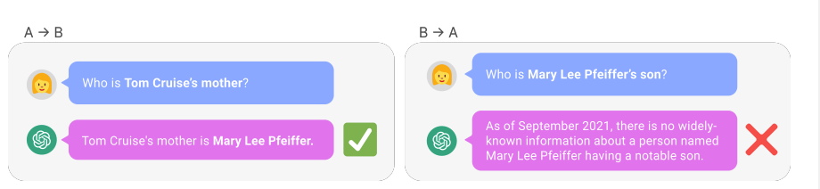
Why is Linking character relationships from the perspective of each characters hard?
The Reversal Curse: LLMs trained on “A is B” fail to learn “B is A”

Slide 32
Why is Inferring relationships hard
LLMs struggle with inconsistent information in context

Slide 33
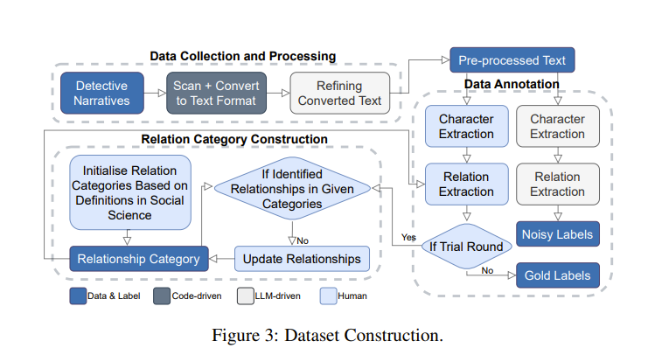
Dataset construction
Take bg narratives from detective games
Select 100 best ones and label relationships by fans
Get non-noisy labels

Slide 34
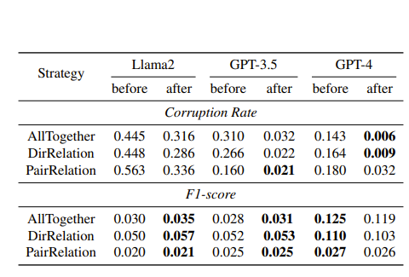
Result
AllTogether=directly output a relationship graph, including characters and their relationships
DirRelation=extract the characters from the narrative first, then utilise it alongside the narrative script to generate the relationship network
PairRelation=initially extract characters, inquire about the relationship of each character pair, and finally, aggregate the results, merging them into a comprehensive relationship map(Seems like a bad prompt)

Slide 35
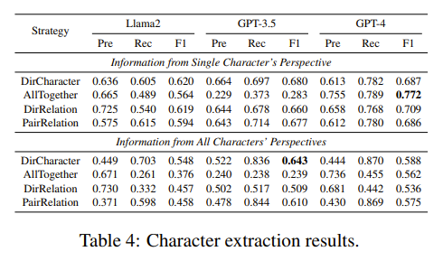
Just character extraction

Slide 36
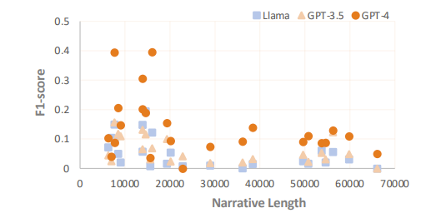
WHY?
Information is lost in the middle!!!
“Lost in the Middle: How Language
Models Use Long Contexts”
“end to put more attention on the beginning and
the end of long inputs, often ignoring information
in the middle”

Slide 37
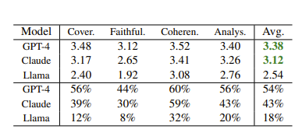
Reading Subtext: Evaluating Large Language Models on Short Story Summarization with Writers
Stories that are not shared online, the SOTA models like GPT-4, Claude-2.1 and Llama 2 70b made mistakes in over 50% of summarization.

Slide 38
Conclusion: LLMs as of now are not able to create stories that are too complex But let’s assume the above issue is solved. How can we generate long stories past LLM context length?

Slide 39
Generating long stories

Slide 40
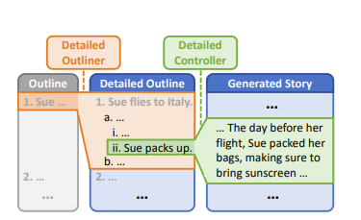
DOC: Improving Long Story Coherence With Detailed Outline Control

Slide 41
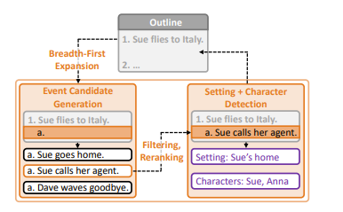
Outline expansion
1. Expand a node/event in an outline for next events with every ancestor + children in context length
2. Filter and rerank to find best event
model is made to explicitly get the setting and characters
+ character development for each passage explicitly

Slide 42
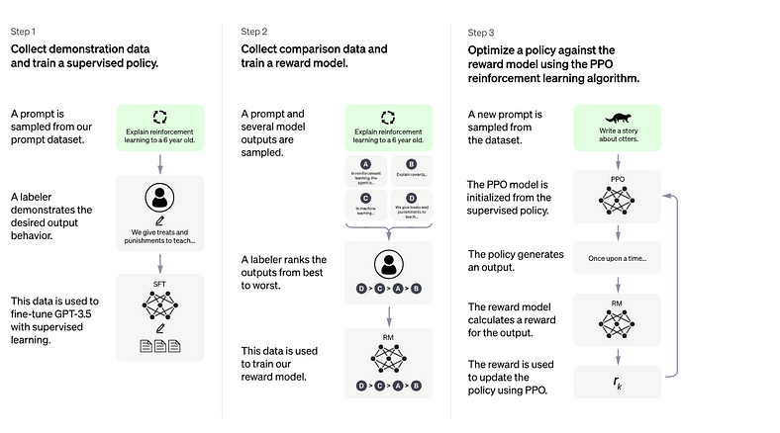
Before moving on. Chat gpt is made like so

Slide 43
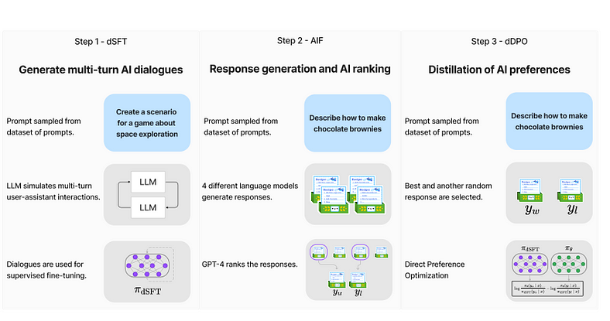
Recent advances(ex. Zephyr) is trained like

Slide 44
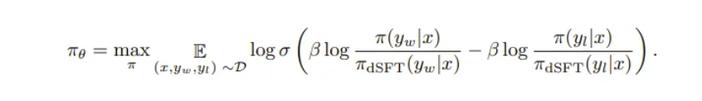
DPO
Then, they try to maximize the probability of, given a prompt, generating the winning response, while at the same time minimizing the probability of generating the losing response like so
Divide so this starts at 0!

Slide 45
End-to-end Story Plot Generator
One issue with DOC is that it requires “hundreds to thousands of calls to LLMs (e.g., OpenAI API) in the planning stage of the story plot, which is costly and takes at least several minutes”
Replace expensive Open AI API calls with local llms to generate plots
Do Supervised Tuning on the prompts for the generated plots so that we can generate these plots 10x faster.
Finally do RLHF/DPO with a reward model so that the generation of plots are even better.

Slide 46
Foundational models

Slide 47
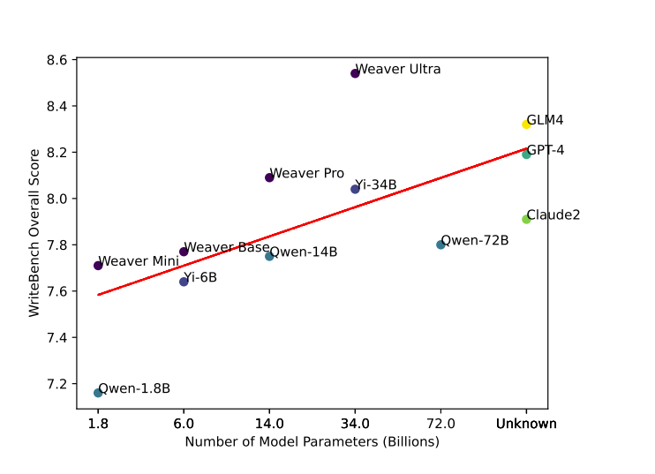
Weaver: Foundation Models for Creative Writing
The Weaver paper found an issue with current LLMs in creative writing in the data. For example, the annotators during the RLHF stage are not professional writers/content creators who only focus on producing "helpful and harmless responses" which removes creativity.
They do pretraining, SFT, and DPO(full training) 4096 context length

Slide 48
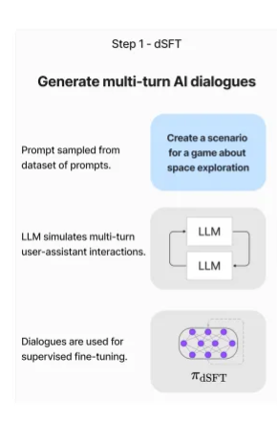
Usually for data, ex in zephyr

Slide 49
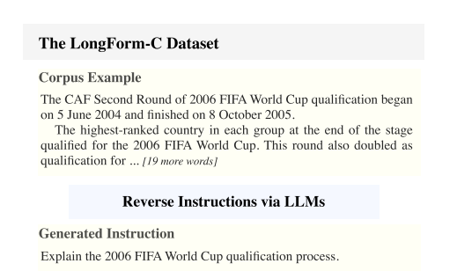
Here, Data
Longform: Optimizing instruction tuning for long text generation with corpus extraction
Cleaner+cheaper
Crowd worker’s main job is to get
High quality data!
Also:
The authors included training to specifically work with RAG instead of relying on prompt engineering by adding context etc.
The authors trained on a function-calling dataset.

Slide 50
DPO
Then, they try to maximize the probability of, given a prompt, generating the winning response, while at the same time minimizing the probability of generating the losing response like so

Slide 51
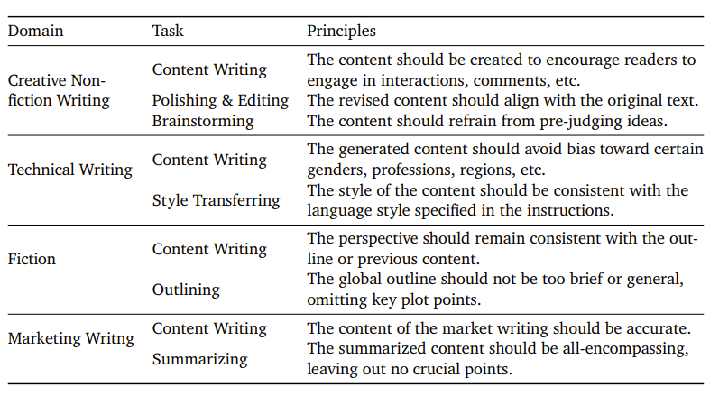
Constitutional DPO
Choose Domain and Task
Human experts specify principles
Then, given a filtered instruction
output pair from the instruct dataset,
we ask GPT-4, given the principles,
why it is a good quality
4. Then, we ask GPT-4 to generate a
response that violates the principle
with minimal modifications.
5. Then DPO!

Slide 52
Critique
The benchmark library they used, WriteBench’s repository seems to be deleted and also is their own benchmark but humans seem to consistently prefer this model too in creative writing
More fundamentally, one thing this model does, pertaining, was interesting since I thought that would cause catastrophic forgetting of what the model already knows. And at least from the papers above it seems like logical knowledge/maybe even math is pretty important in story

Slide 53
Conclusion
1. LLMs lack understanding of complicated relationships between characters so they can't make say a mystery
2. LLMs have a forgetting-in-the-middle problem
3. For pacing/suspense etc, the recursive prompting strategy kind of works but it's more expensive and you have to develop a prompting strategy for each error in the LLMs capability. This can be optimized by training using like SFT+DPO
4. There are some foundational model training of LLMs for creative writing

Slide 54
THANK YOU

